Slide 1
SPORT SOCIAL NETWORK
Trương Văn Quốc Hoàng
Nguyễn Đình Kha
Nguyễn Minh Hiếu
Văn Đức Dũng

Slide 2
Agenda
Introduction
Product functions
Design and architecture
Way of working
Conclusion
Demo

Slide 3
Introduction
The team: 4 members: Hoàng, Dũng, Hiếu, Kha
The customer: Mr.Han Ho & Mrs Dung Huynh
The project: Sport Social Network

Slide 4
Sport Social Network
Purpose:
Social network for football lover
Easy to create match
Easy to see and join match
Help to create tournament
Find good player
Make friend

Slide 5
Sport Social Network
Platform:
Web application
Future: mobile

Slide 6
Product functions
Create Profile: user can have a “football profile” with rating, and skill
Create match:
Create match with specific date time
Anyone can join
Share to people
Update images, detail and comment about match

Slide 7
Product functions
Talent wanted
Create tournament:
Create tournament
Anyone can join
Share to people

Slide 8
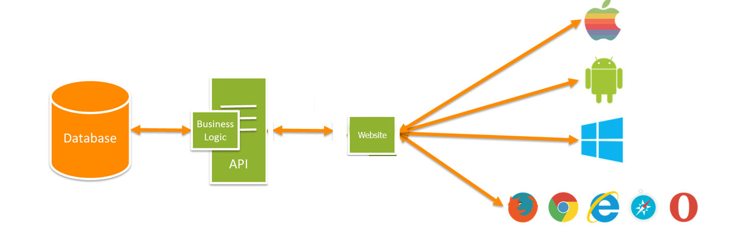
Design and architecture

Slide 9

The API Server: Laravel
Why Laravel?
Quick Emergence
Open source
MVC architecture support
Libraries and configuration

Slide 10
The API Server: Laravel
RESTful API
Data structure: JSON
Authentication: access token (OAuth2 passport)
Logical resources:
GET /users
POST /users
PUT /users/:id
DELETE /users/:id
API versioning

Slide 11
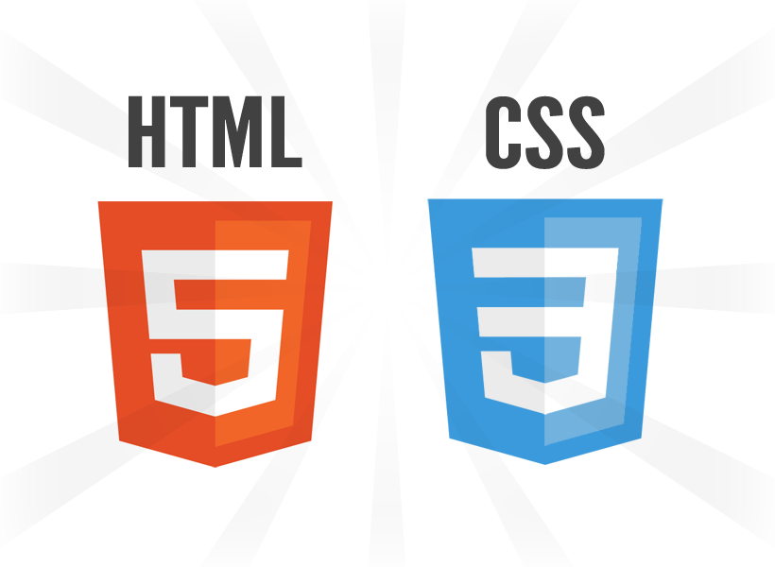


The Website
Technology:
HTML5/CSS3
Bootstrap
AngularJS

Slide 12
Way of working
Scrum
Waffle as project managemet tool

Slide 13
Conclusion

Slide 14
Demo

